Slide 1
Diet, Food & Dining
The Roman dining experience

Slide 2
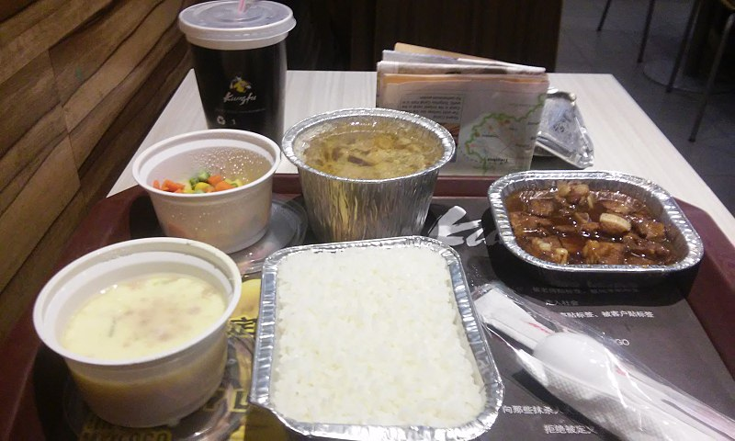
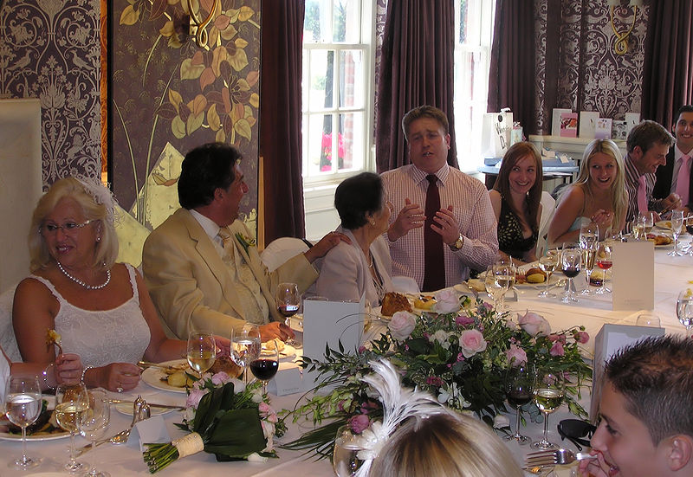
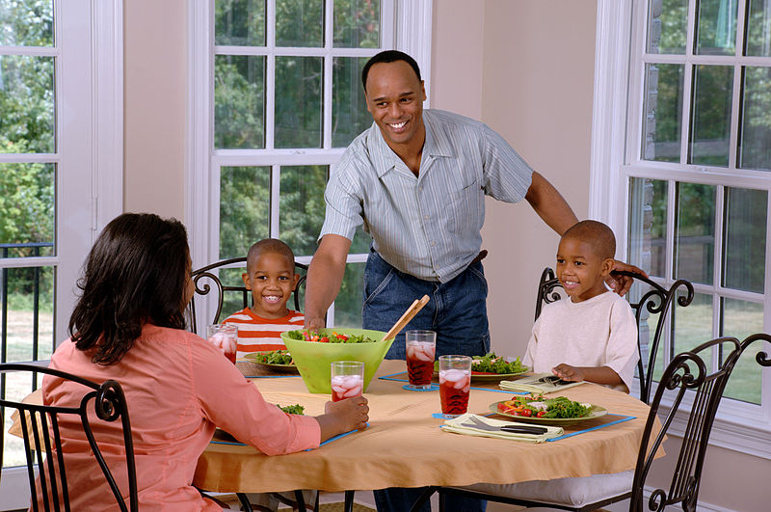
Food & dining today
How do we consume food today?
How do we use food as part of social life?

Slide 3
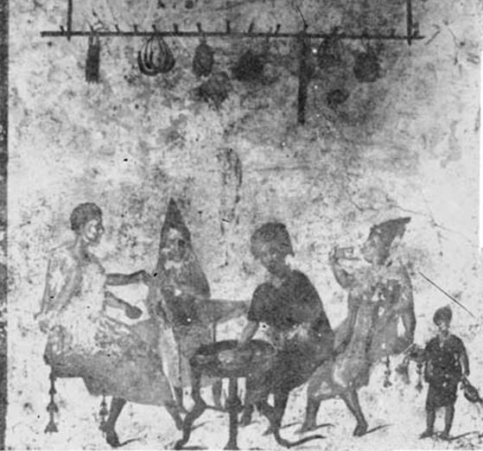
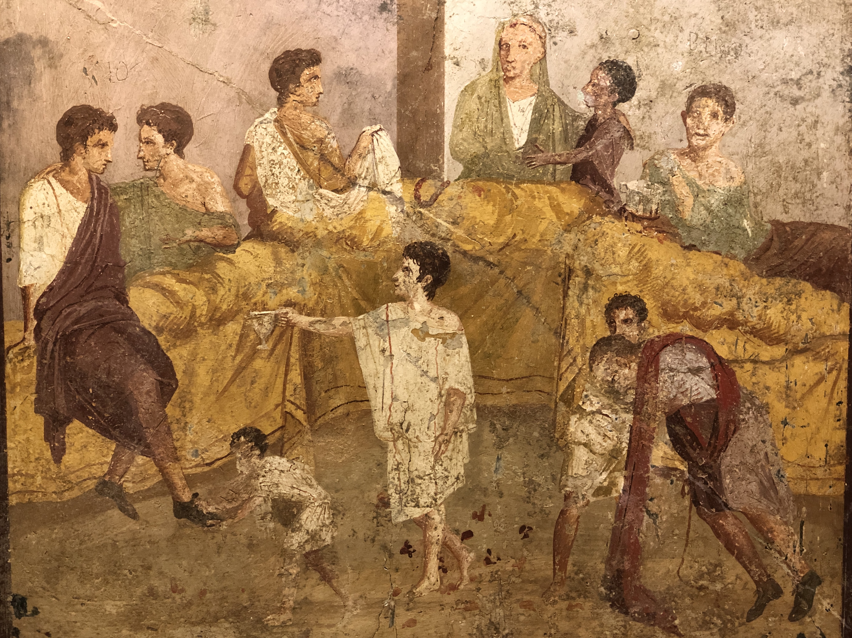
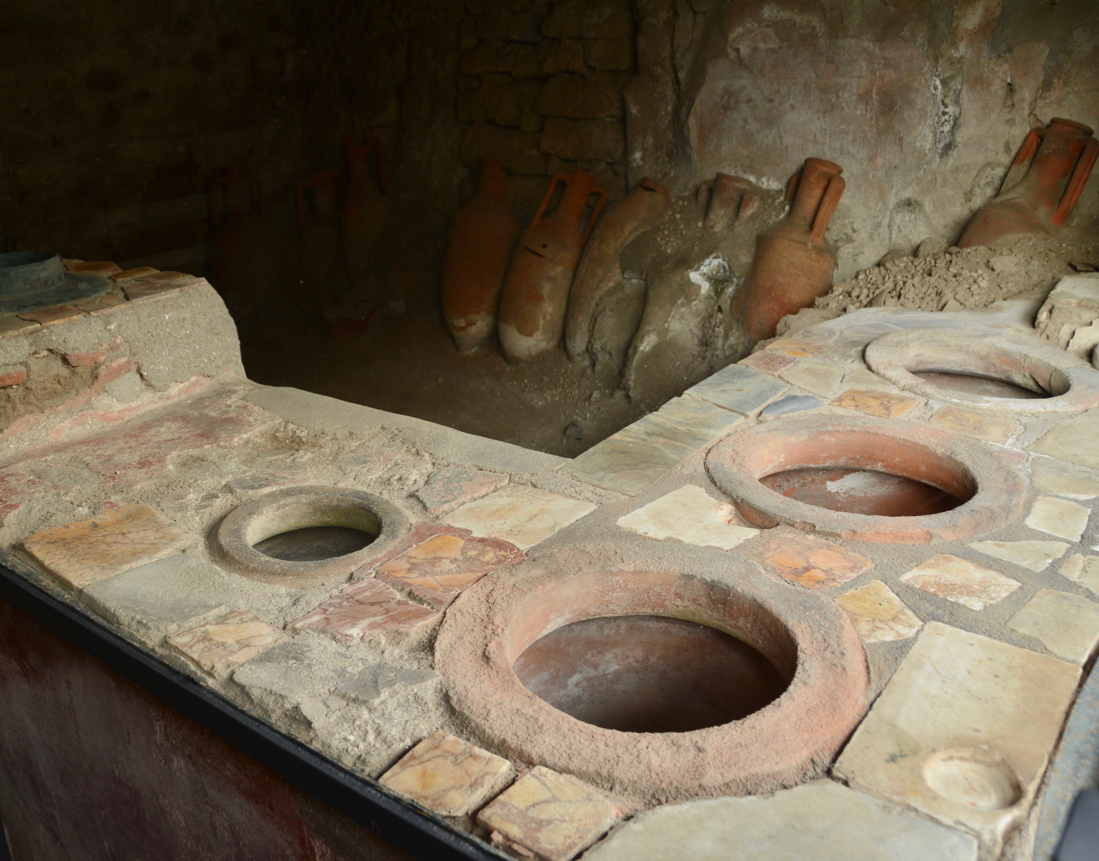
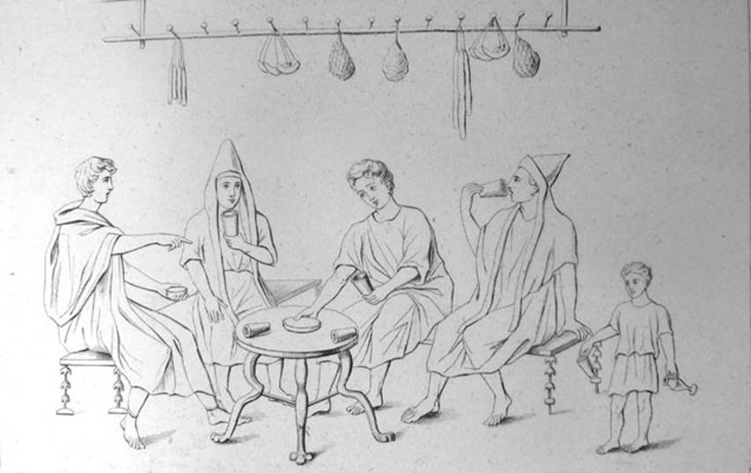
What’s happening here?

Slide 4
Eating experiences in Roman Pompeii
Just like today, food could be eaten quickly simply to satisfy hunger or more socially …
… maybe in a bar like Amarantus’ or from a shop that sold takeaway hot food (called a thermopolium) …
…or as part of a social event in the home, like a dinner party…
… or a wedding feast

Slide 5
What do we already know about Roman dining?

Slide 6
Dining & social status
middle couch
b
a. host’s position
b. top position of honour
c. position of honour
d. position of honour
a
table
c
d
top couch
What else might a host do at a dinner party if they wanted to really emphasise the social hierarchy?
lowest couch

Slide 7
Source task: Food and status
Read the three sources on your handout.
In your notes:
Make a list of the food and drink that are ‘high status’ and those that are ‘low status’
Suggest what claims we can make about how acceptable this behaviour was in the Roman world
Extension: What do you think made certain food and drink high or low status?

Slide 8
Do you think it’s acceptable to offer different dining experiences to guests depending on their status?
Do we use food and dining to show status in the modern world?

