Slide 1
Topic 3: Roman Beliefs
Chapter 1: Public and household religion

Slide 2
Roman Gods
The Romans worshipped a “pantheon” of gods
“pan” from the Greek for “all”
Panorama (all-view)
Pandemonium (all-demons)
“theon” from the Greek “theos” for “god”
Their religion was “polytheistic”
“poly” from the Greek “polu” meaning “many”
Polygon (many-angles)
Polymath (many-learnt things)
And “theistic” again from the Greek “theos” for “god”

Slide 3
Starter activity
Work in pairs to write the names of as many Roman gods as you can on a slip of paper.
Hint: Some gods have been mentioned in the story already – think back to these if you can.

Slide 4
Religion in Pompeii
The ancient Pompeians worshipped their gods through ceremonies and rituals.
These often involved worshippers making offerings or sacrifices to the gods.
The purpose was to please the gods, so that they would do good things for the worshippers.
This relationship of give and take is expressed in the Latin phrase “do ut des” which means “I give so that you will give”.

Slide 5
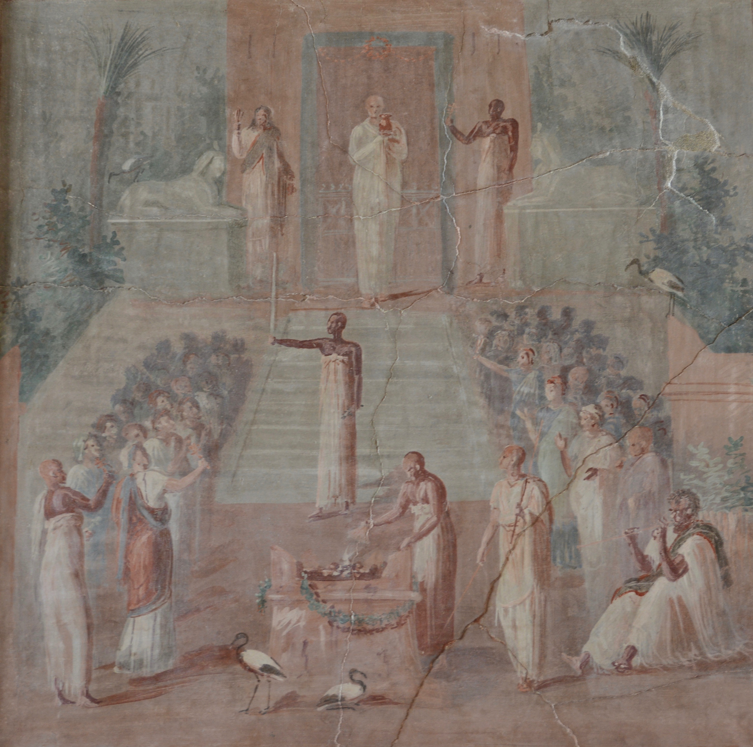
Public Rituals
This wall painting depicts a public religious ritual.
We can tell it is a public ritual because it takes place outside and many people are participating.
Work through the questions on your worksheet to see what else you can work out about this ritual.

Slide 6
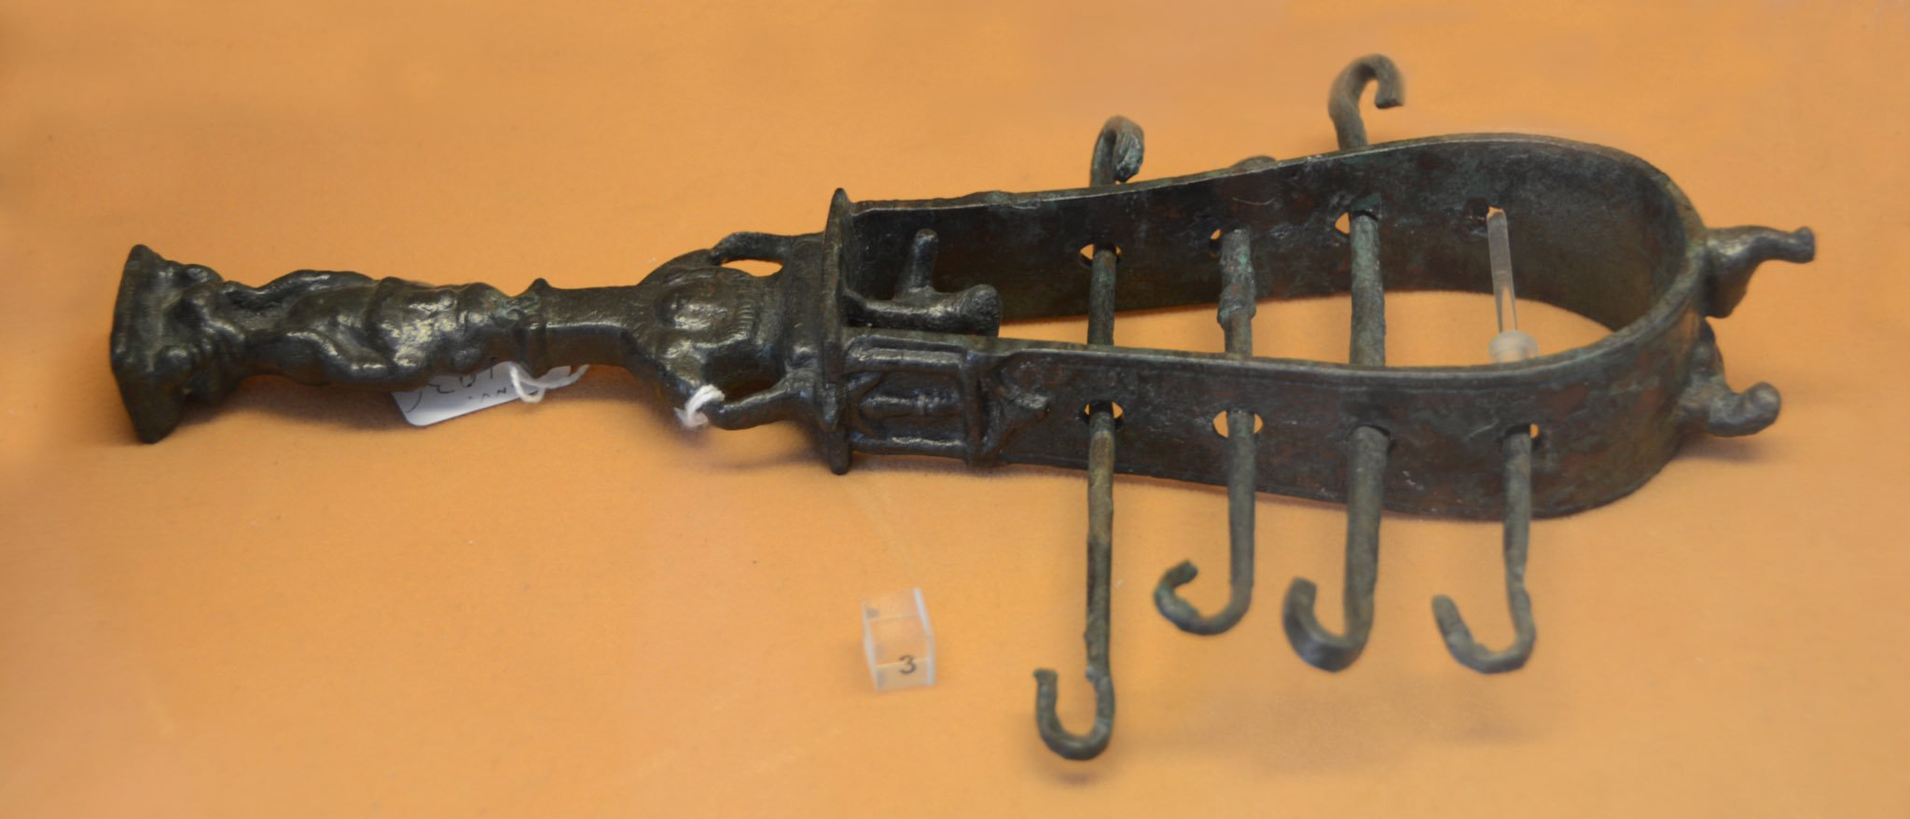
Did you spot?

Slide 7
Public Rituals
Creative task: write a detailed description of the scene. Try to include detail from all 5 of your senses (sight, smell, sound, taste, touch).

Slide 8
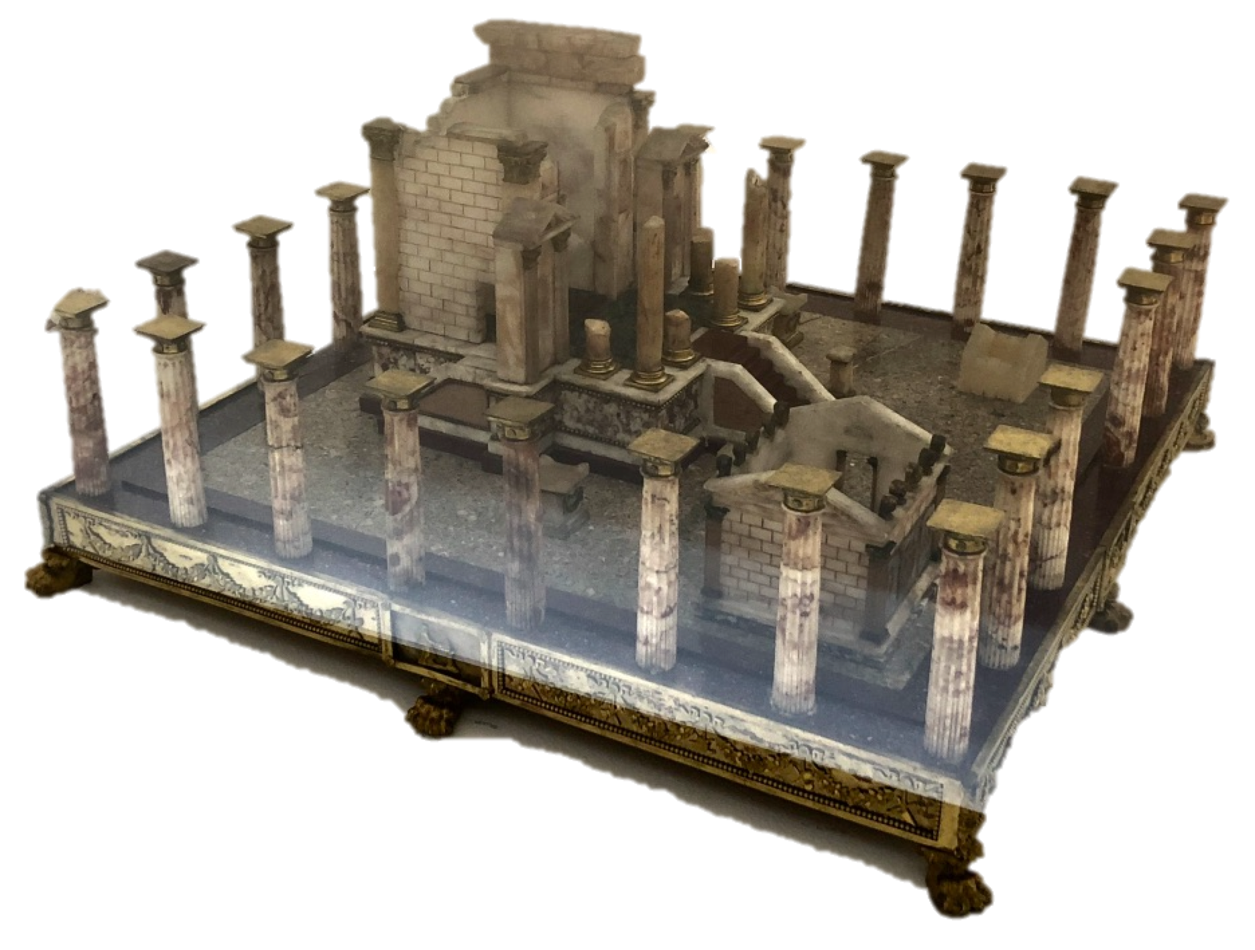
Religious Buildings: Temples
Pompeii contained many religious buildings, called temples.
A temple was a sacred building that was thought to be the home of a god or goddess.
Temples could be built and paid for by the government or by private individuals who wanted to show devotion to the god, or just to show off!
Rituals, like the one in the wall painting, would often take place outside a temple.
Model of the Temple of Isis

Slide 9
Optional Extension: Map of the Forum of Pompeii
Key :
Green: Shops
Orange: Religious
Red: Political
Reminder: What is a forum?
Written explanation practice:
What can you tell from the plan of the Forum of Pompeii about the importance of religion in their culture?
Writing frame:
It seems as though religion in Pompeii was…
This is because the Forum of Pompeii has…
This could imply that…

Slide 10
Household Religion
Each family had its own personal domestic guardian deities, known as Lares
They guarded the house, especially the storeroom, and the family members
Lares were normally shown as young men in short tunics
Most houses had their own private shrine for worshipping the Lares called a lararium
The family’s ancestors would also be honoured at the household shrine.

Slide 11
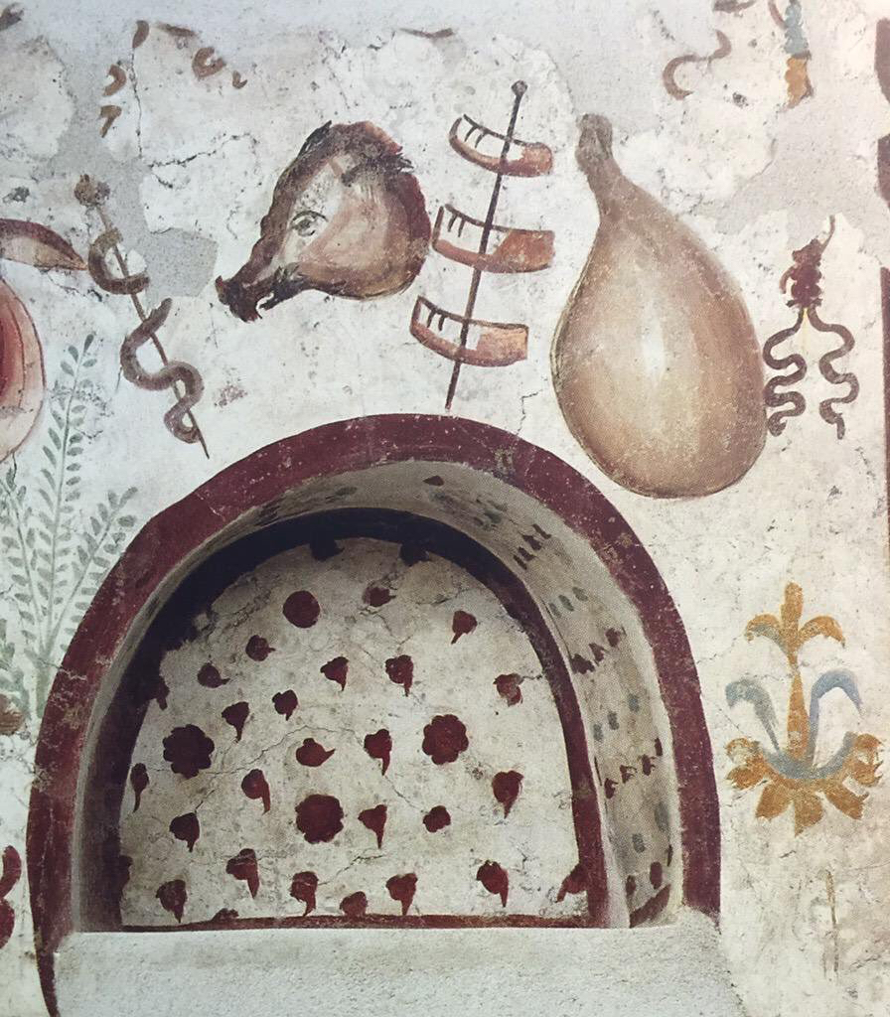
Household Religion
The male head of the household (the paterfamilias) was responsible for leading the household worship.
He would leave small offerings at the shrine.
Everyone in the family participated in household religion, from the paterfamilias to the children to the slaves.

Slide 12
Household Religion
Household shrines were very varied.
For example, whilst Jupiter (king of the Roman gods) was a very important part of public religion – he has lots of temples – he barely ever appears on household shrines.
Much more popular are shrines featuring pictures of Hercules, Venus and Bacchus, each of which had been very popular in Pompeii since before it became a Roman colony in 80 BCE.
What do these facts suggest about household religion in Pompeii?

Slide 13
Comparing public and private religion
What are the similarities and differences between public and household religion?

